Slide 1

Artificial Intelligence
Lecture 2
By/ aly maher abdelfattah

Slide 2
Environment Properties
Fully observable vs. partially observable
Deterministic vs. stochastic/strategic
Episodic vs. sequential
Static vs. dynamic
Discrete vs. continuous
Single agent vs. multiagent

Slide 3
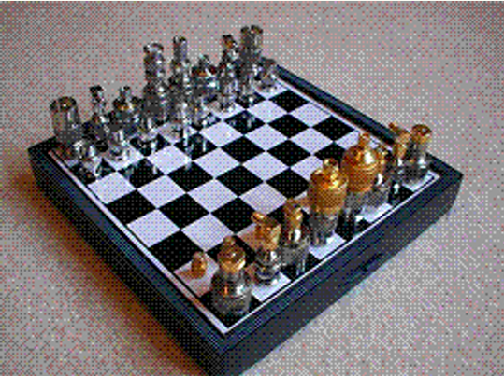
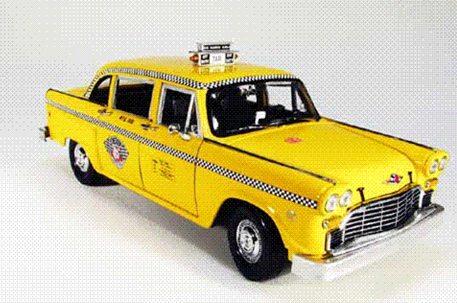
Fully observable vs. partially observable
Property | Description | Example
Fully observable | The agent has access to the complete state of the environment at each point in time. | Chess
Partially observable | The agent does not have access to the complete state due to noisy/inaccurate sensors or missing information. | Automated taxi

Slide 4
Deterministic vs. stochastic/strategic
Property | Description | Example
Deterministic | The next state of the environment is completely determined by the current state and the action executed by the agent(s). | Chess
Stochastic/Strategic | The next state of the environment is not completely determined and includes randomness or strategic interactions. | Automated taxi

Slide 5

Episodic vs. sequential
Property | Description | Example
Episodic | The agent’s experience is divided into atomic episodes where the next episode does not depend on previous actions. | Classification tasks (eg. Medical Diagnosis)
Sequential | Current decisions affect all future decisions. | Chess, Automated taxi

Slide 6
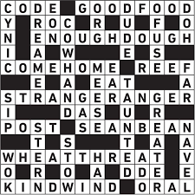
Static vs. dynamic
Property | Description | Example
Static | The environment does not change while the agent is deliberating. | Crossword puzzles
Dynamic | The environment can change while the agent is deliberating. | Automated taxi

Slide 7
Discrete vs. continuous
Property | Description | Example
Discrete | The state, time, and percepts/actions of the environment are in a finite number of discrete states. | Chess
Continuous | The state, time, and percepts/actions of the environment are continuous. | Automated taxi

Slide 8
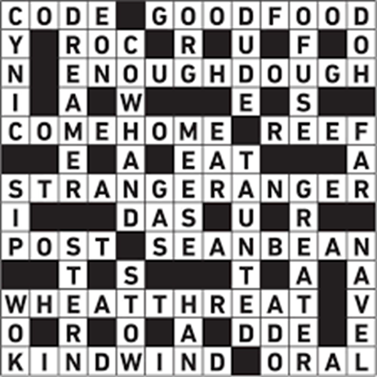
Single agent vs. multiagent
Property | Description | Example
Single agent | Only one agent is involved in the environment. | Crossword puzzle
Multiagent | Multiple agents are involved, which may involve cooperation or competition. | Chess

Slide 9
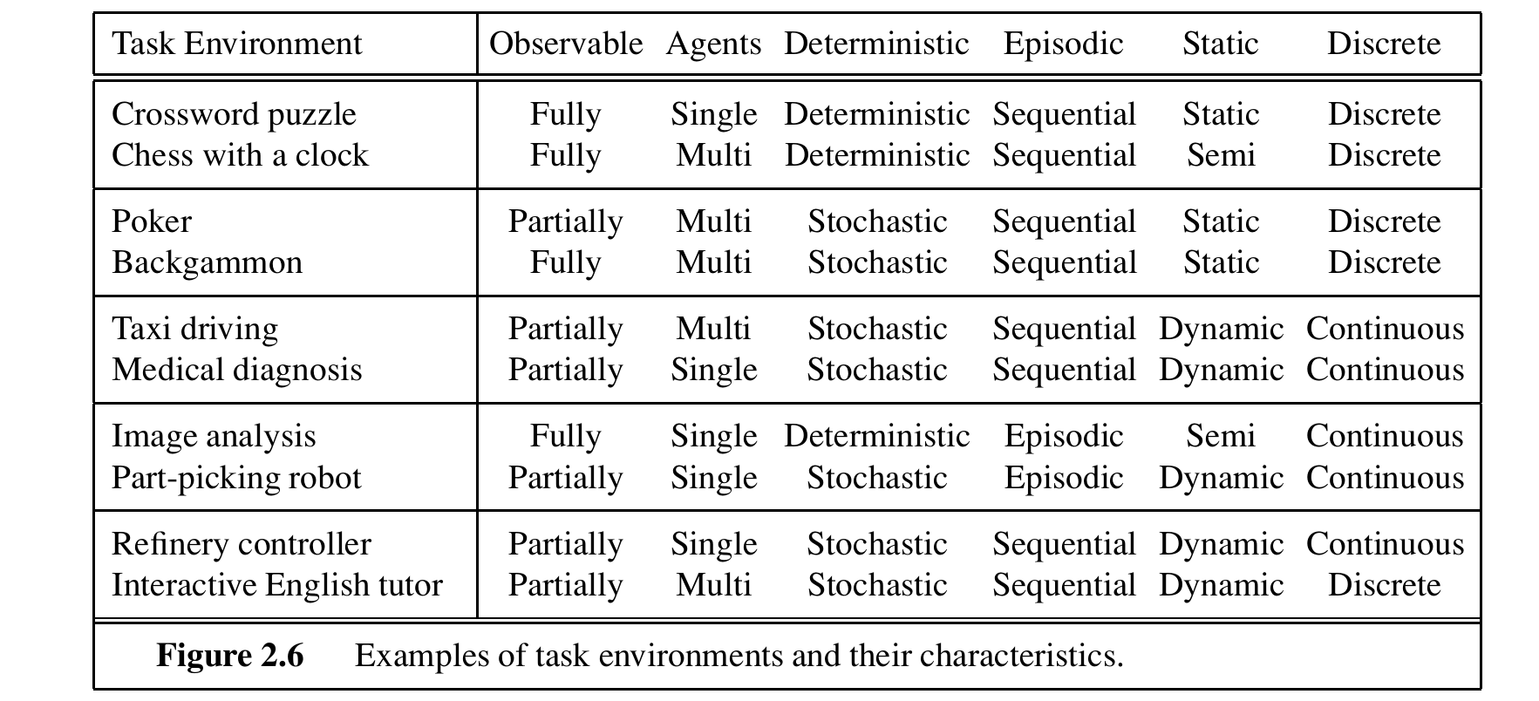
Environment Properties

Slide 10
Agent Types
The job of AI is to design an agent program that implements the agent function—the mapping from percepts to actions.
We assume this program will run on some sort of computing device with physical sensors and actuators—we call this the agent architecture
agent = architecture + program
If the program is going to recommend actions like Walk,
• The architecture had better have legs.
• The architecture might be just an ordinary PC, or it might be a robotic car with several onboard computers, cameras, and other sensors

Slide 11
Agent Types
Types of agents:
• Simple reflex agents
• Model-based reflex agents;
• Goal-based agents
• Utility-based agents
• Learning agent

Slide 12
Agent Types
Agent Type | Description | Key Features | Example | Advantages | Limitations
Simple Reflex Agents | Select actions based on the current percept, ignoring the rest of the percept history. | Use "if-then" rules | Vacuum agent with "suck", "left", "right" actions | Fast decision-making, simple implementation | Short-sighted, can fall into infinite loops
Model-Based Reflex Agents | Handle partial observability by keeping track of the part of the world they can't see now. | Internal state, transition model, sensor model | Advanced vacuum agent with state tracking | More effective in partially observable environments | More complex than simple reflex agents
Goal-Based Agents | Make decisions based on goals that describe desirable situations. | Goal information, decision projection | Automated taxi navigating based on destination | Can make more informed decisions aligned with long-term goals | Requires more time for reasoning, world may change during reasoning

Slide 13
Agent Types
Agent Type | Description | Key Features | Example | Advantages | Limitations
Simple Reflex Agents | Use a utility function to compare different world states and decide based on the highest utility. | Utility function, performance measure | Automated taxi optimizing for speed and safety | Allows for trade-offs between conflicting goals, higher quality behavior | Requires defining a utility function, more complex reasoning
Learning Agents | Improve performance over time using feedback from their environment. | Learning element, performance element, critic, problem generator | Adaptive robot learning new tasks | Can adapt to new environments and improve performance | Requires a learning phase, potentially slow initial performance

Slide 14

Thank you

